Slide 1
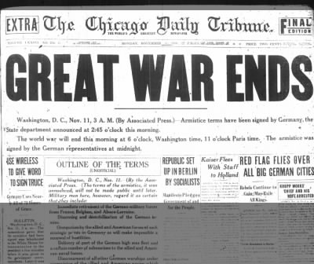
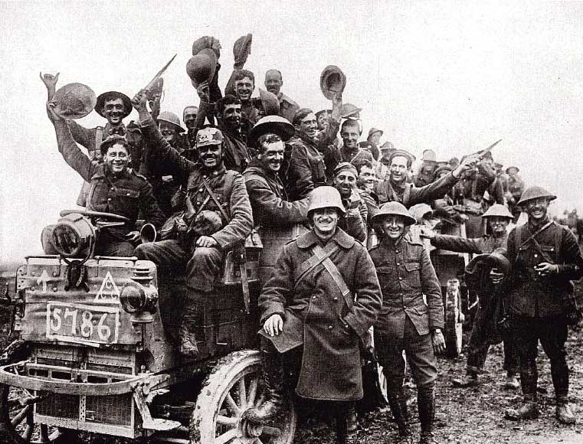
WWI ENDS

Slide 2
TURNING TIDES OF 1917…KIND OF
Eastern Front
Russian Revolution leads to Russian withdrawal from WWI
What’s the benefit for Germany??
Western Front
United States joined late WWI
What’s the benefit for the Triple Entente forces??

Slide 3
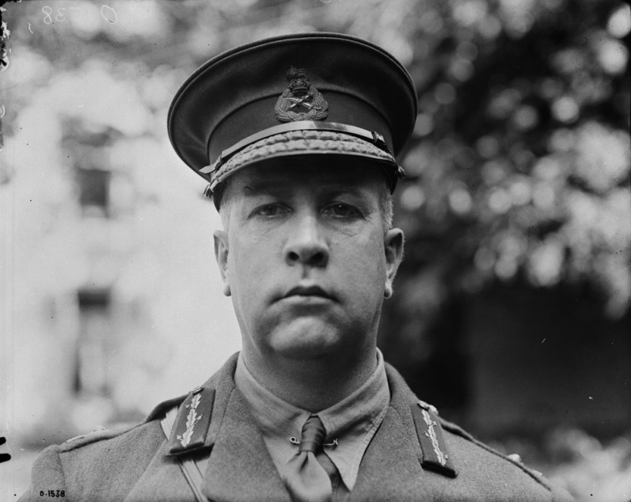
HUNDRED DAY OFFENSIVE
Began August 8, 1918
British Generals had the idea to break up the Canadians and mix them in w/ other regiments
Why would they suggest this? (CAUSE)
Currie insisted nothing changed (and won the argument)
With Currie in charge, what would that imply about how Canadians were fighting??

Slide 4
CANADIAN CONTRIBUTION
Canadians won important battles at Arras, Cambria & Valenciennes
We captured more territory, prisoners & equipment than the American forces that were six times our size
Canadians defeated ¼ of the entire German army
“The Battle for the Canal du Nord was arguably the single greatest achievement of the Canadian Corps. An all by impregnable position had been taken, thanks to an imaginative plan, almost flawless execution, massive fire support, and the matchless courage of the Canadian soldiers.”
What do these statistics say about our efficiency??? What could you claim about WWI Canadian soldiers?

Slide 5
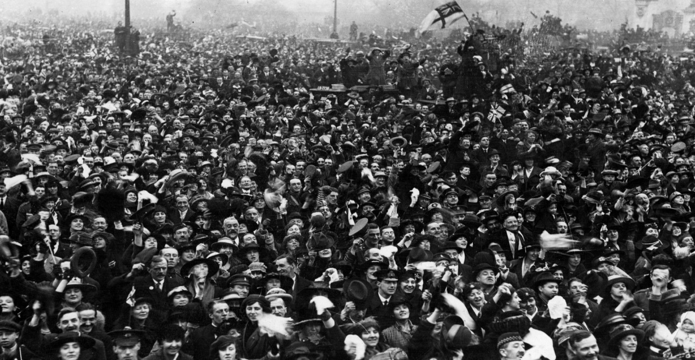
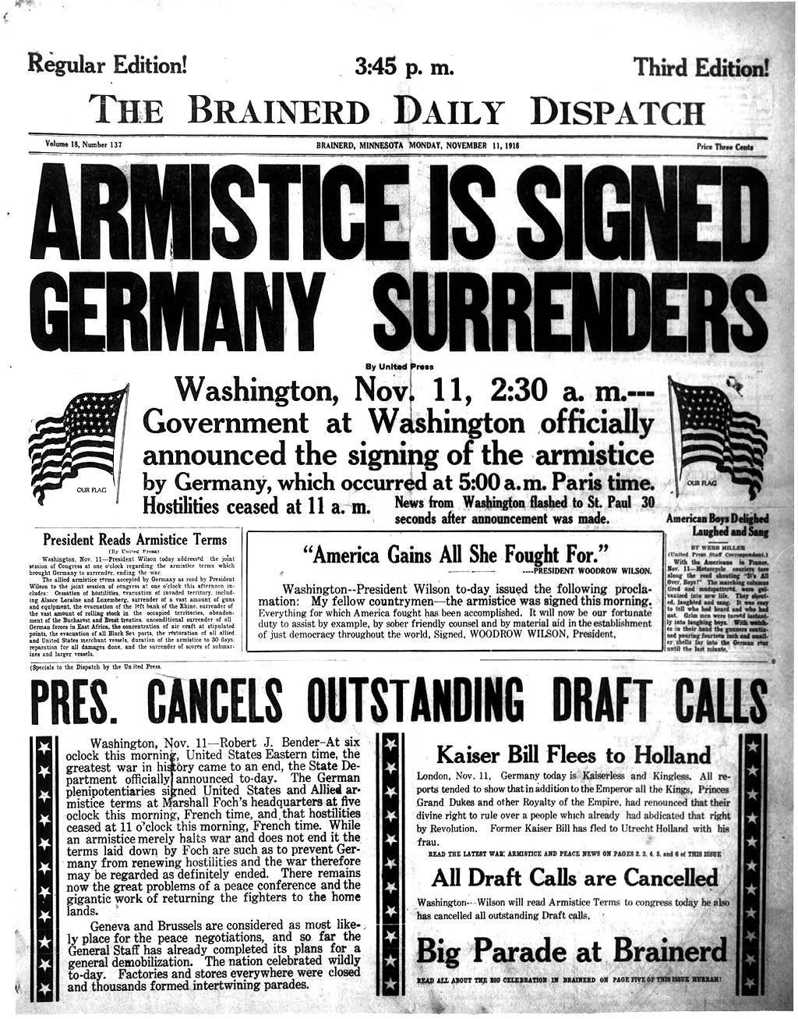
ARMISTICE
Central Powers were collapsing one by one
Fighting ended at 11:00 am on November 11, 1918
Any special significance??
George Lawrence (Canadian Private) last soldier killed

Slide 6
ROBERT BORDEN
Rep. for standing strong against Britain
At Imperial War Cabinet Meeting in June 1918, Borden grabbed & shook British PM Lloyd George
“Mr. Prime Minster, I want to tell you that if there is ever a repetition of Passchendaele, not a Canadian soldier will ever leave the shore of Canada as long as the Canadian people entrust the Government of my country to my hands.”
Would Borden have done this in 1914? What caused this shift?
Ensured Canadian participation at Paris Peace Conference
U.S. & Britain opposed our participation
Why should we be there over the States?
Canada sent 4 delegates – including Borden

Slide 7
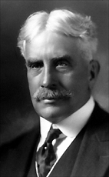
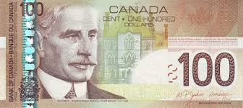

Slide 8
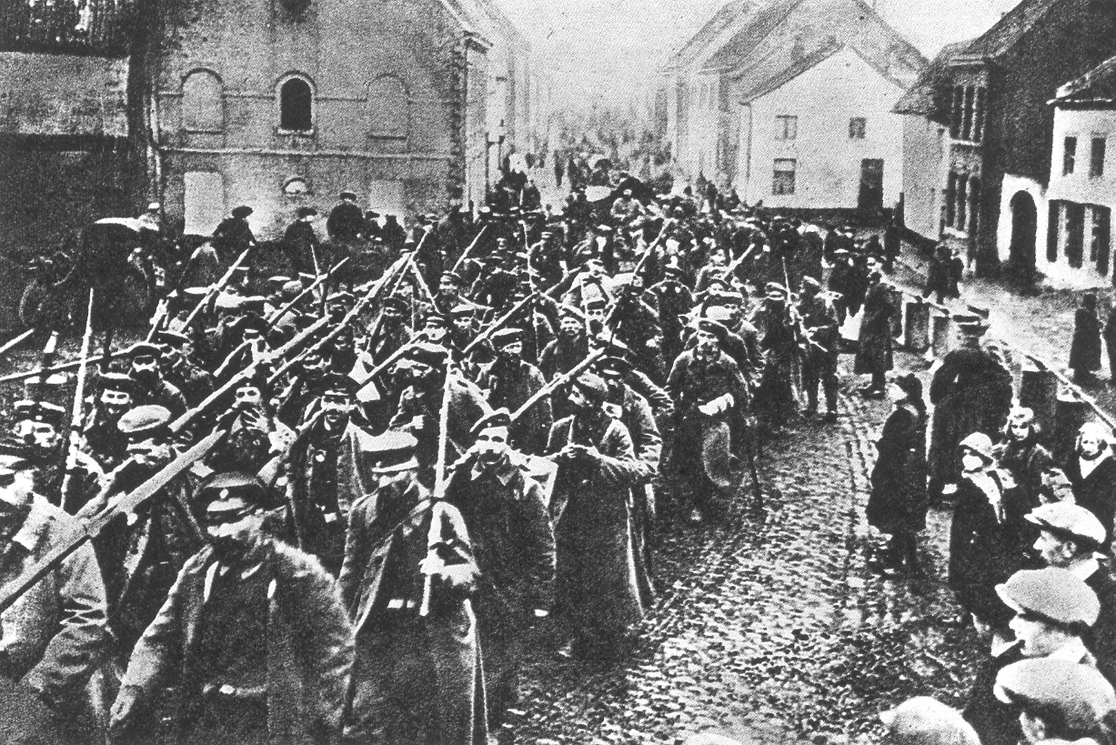
But how would the Allies deal with a defeated Germany?

Slide 9
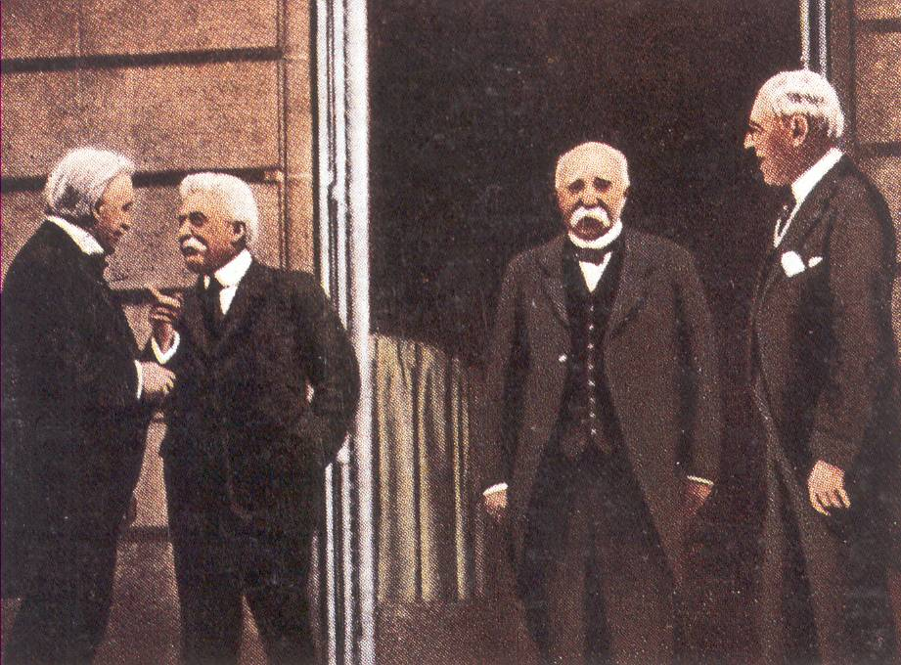
David Lloyd-George [Great Britain]
Woodrow Wilson [USA]
Orlando [Italy]
Georges Clemenceau [France]

Slide 10
TREATY OF VERSAILLES
Woodrow Wilson – US President
14 Points – emphasized peace & forgiveness
WHY??
George Clemenceau – French Prime Minster
Demanded revenge & repayment
WHY??
Who would win? WHY??

Slide 11
LAND CONDITIONS
1. Alsace & Lorraine were returned to France.
2. Germany lost land to Denmark & Belgium.
3. Eastern Germany was ripped apart to create the new country of Poland.
4. German colonies were taken away.
5. Polish Corridor provided access to the sea for Poland and separated East Germany from the rest of Germany.

Slide 12
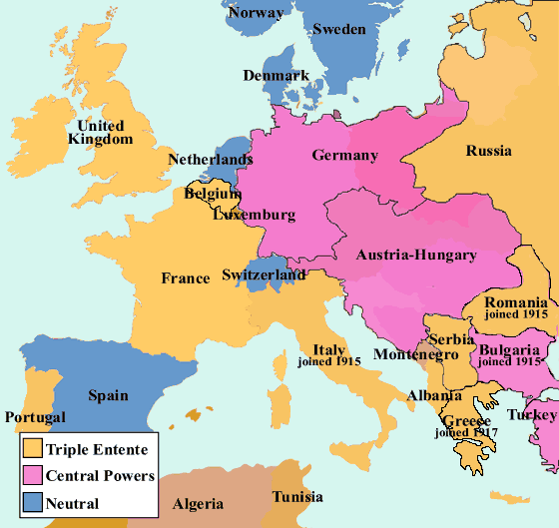
1914--------------------1919

Slide 13
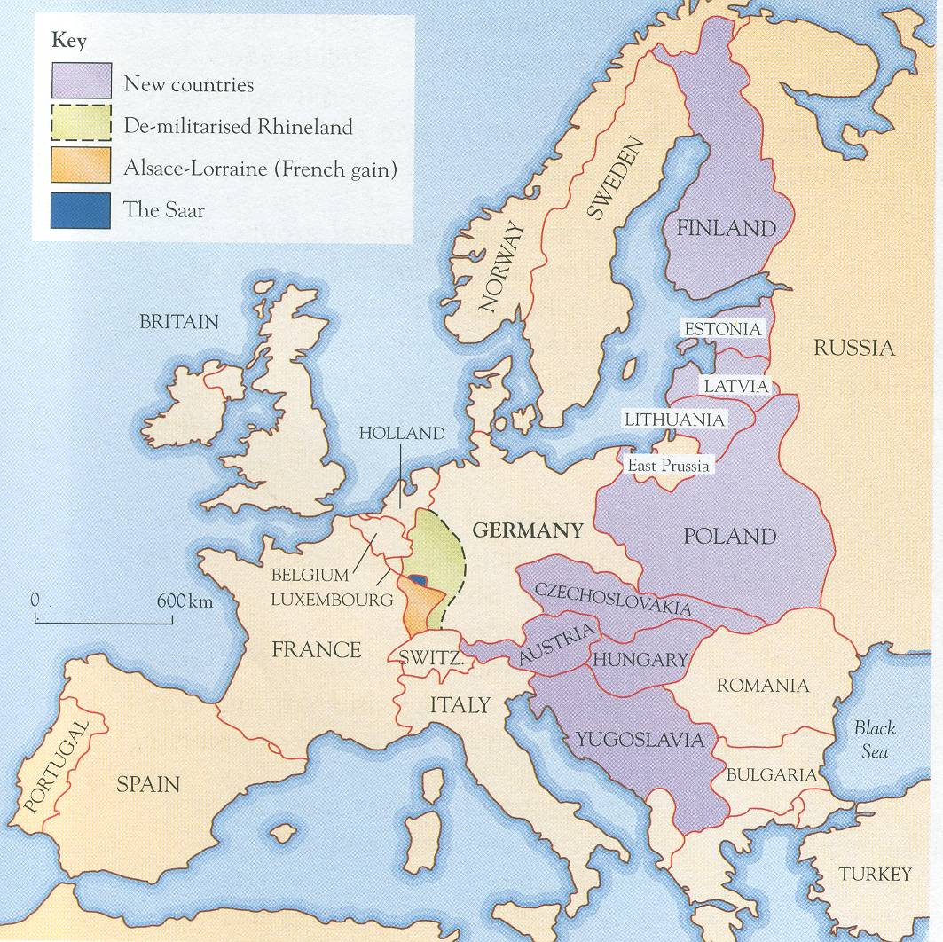
The map of Europe was redrawn
The Great War was to see the collapse of four continental empires. These were to be replaced by new nation states.

Slide 14
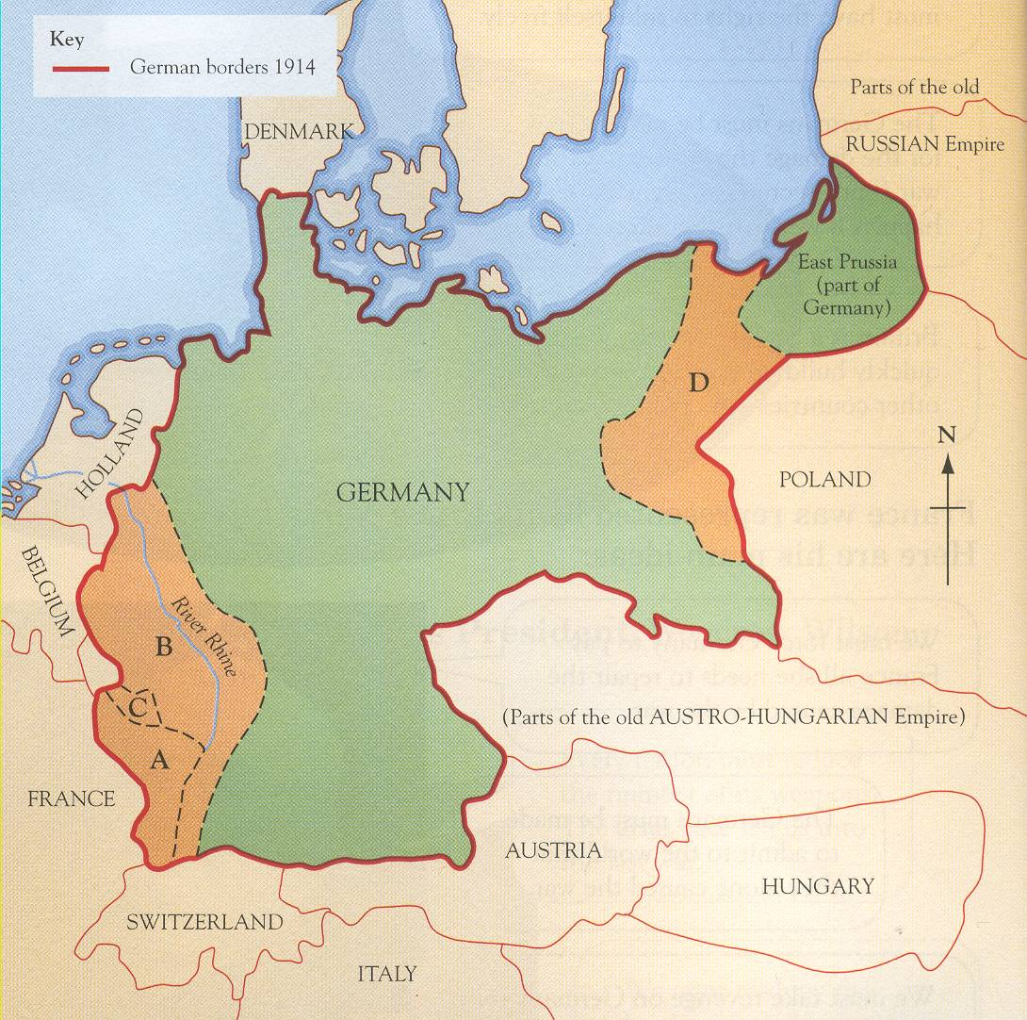

Slide 15
MILITARY CONDITIONS
6. Allies were to occupy the Rhineland for 15 years and afterwards it was to be an undefended zone.
7. The German navy was destroyed, her army was reduced to 100000 soldiers, and they were banned to have planes, tanks, or subs.
8. Germany and Austria were never to unite.

Slide 16
Describe the scene shown, what is the storyline?
Then, assess the individual features in the cartoon.
Then, identify the political message intended by the cartoonist.
Source 2:
‘Punch’ was Britain’s main political magazine of the period.
Why the candle ‘snuffer’? What political message does it represent?
What does the ‘Angel’ represent?
What does the candle represent?
What is the general political message of the cartoon?

Slide 17
ECONOMIC CONDITIONS
9. Saar Coalfields to be owned and operated by France for 15 years.
10. Germany was to pay war reparations. Which means Germany was to pay for all costs for all countries. It eventually amounted to $ +30 BILLION.

Slide 18
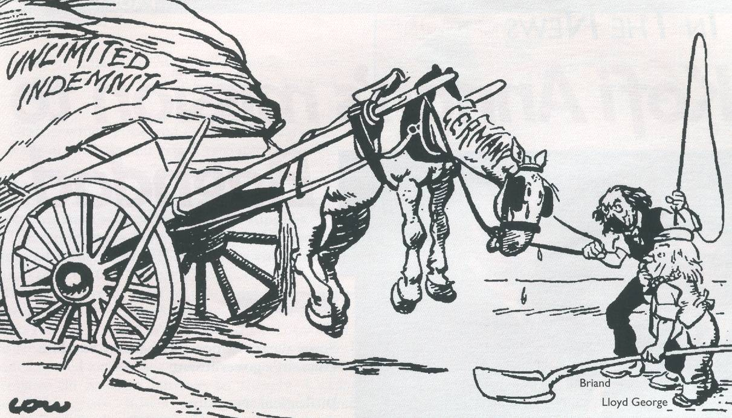
Source 1:
A British newspaper cartoon, by David Low.
SOURCE WORK: 1) First, describe the storyline shown in the cartoon. 2) Then, relate the political message intended by the cartoonist – what does the horse represent, what does the cart represent, why is it stuck in the air, who are the two men, why is one carrying a whip and one a shovel – what is the political message ?
What does the horse represent?
Why is Briand holding a whip?
What is this referring to?
Briand, French Prime Minister
Why is the cart up-ended?
‘Perhaps it would gee-up better if we let it touch earth.’
Why is a shovel left here?
‘Perhaps it would gee-up better if we let it touch earth.’
Lloyd-George, British Prime Minister
What is meant by the caption?
Why is Lloyd-George holding a shovel?

Slide 19
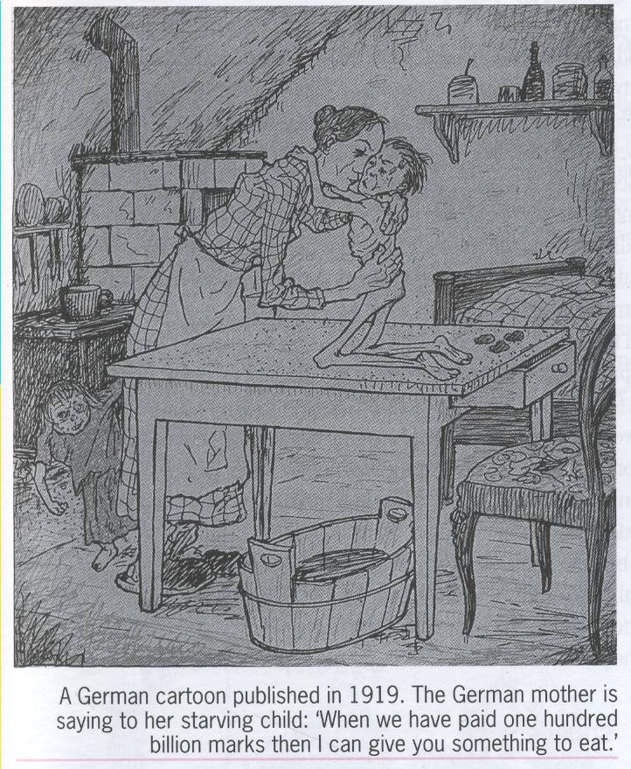
HOW USEFUL IS THIS SOURCE AS HISTORICAL EVIDENCE:
i. What do we learn from it about the period being studied?
ii. How reliable is this source?
Source 4
Describe the condition of the room in which this family is living?
How is the child shown? Why?
Look at the caption, what is its political message?
How reliable is this source?

Slide 20
GUILT CLAUSE
11. Germany was to sign the Guilt Clause which says WW1 was entirely their fault.
Had to sign, or war was back on
Why is this POTENTIALLY a bit unfair??

Slide 21
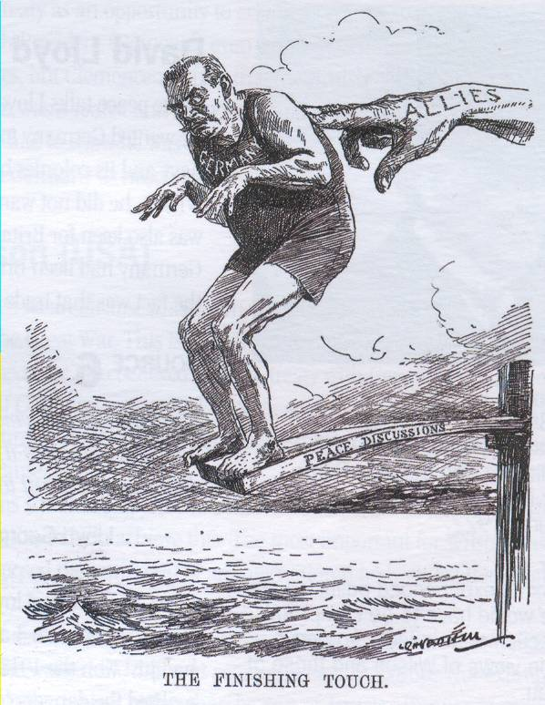
Source 3:
What is the political message of this cartoon?
Describe the scene shown, what is the storyline?
Then, assess the individual features in the cartoon.
Then, identify the political message intended by the cartoonist.
What is being represented by the ‘hand’?
What does the plank represent
‘Who’ / or, ‘what’ is the man representing?
THE FINISHING TOUCH

Slide 22
Vengeance! German Nation
Today in the Hall of Mirrors of Versailles the disgraceful Treaty is being signed. Do not forget it! The German people will with unceasing labour press forward to reconquer the place among nations to which it is entitled. Then will come the vengeance for the shame of 1919.
From the ‘Deutsche Zeitung’ [‘The German Express’] newspaper.
Source 5:
Source 7:
Only fools, liars and criminals could hope for mercy from the enemy. In these nights hatred grew in me, hatred for those responsible for the dead.
By Adolf Hitler, who had served in the army and became a future leader of Germany

Slide 23
COOL FACTS
Treaty was signed on June 28, 1919
Borden was among the signers…against the US objection
Why object??
Borden actually insisted that they delay the signing so the Canadian Parliament could debate its validity
Lloyd George – “We shall have to fight another war all over again in 25 years at 3 times the cost.”

