Slide 1
THE ROAD TO WWI
FOCUS ON – CAUSE & CONSEQENCES
AND
SIGNIFICANCE

Slide 2
MINDS ON QUESTION
1)WHAT IS MORE LIKELY GOING TO LEAD TO CONFLICT:
LONG TERM PROBLEMS WITH SOMEONE OR SHORT TERM PROBLEMS?
2) WHICH DO YOU THINK WOULD MOST LIKELY CAUSE A WORLD WAR?

Slide 3
LONG TERM CAUSES OF WWI
There are actually 4 long term issues that lead to WWI starting
M______________
A_______________
I_______________
N_______________
Anyone notice the easy way to remember these 4??

Slide 4
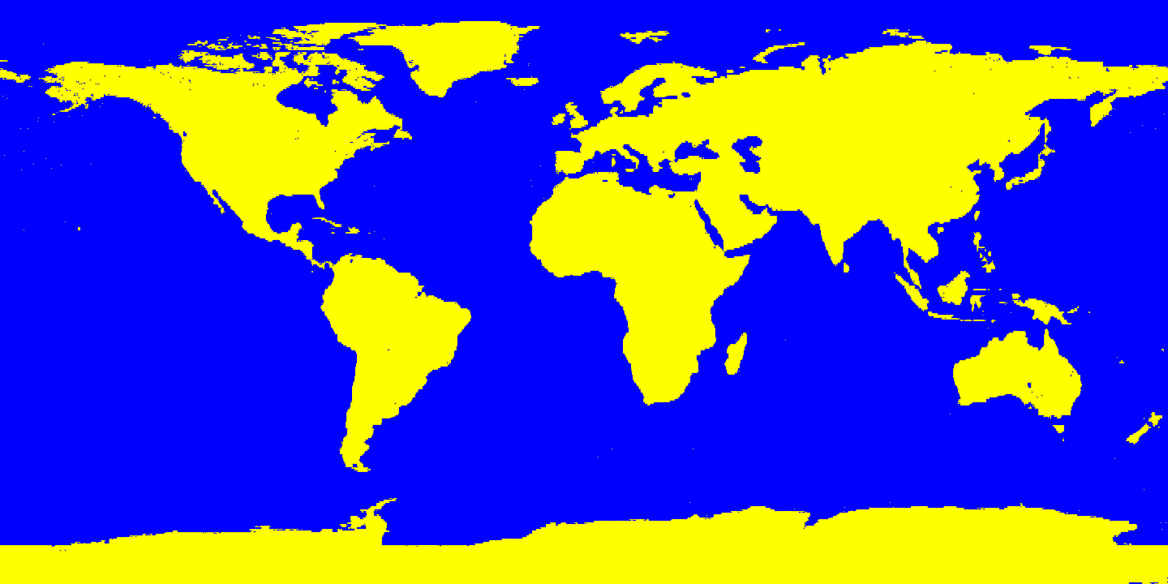
WHERE’D WWI HAPPEN??

Slide 5
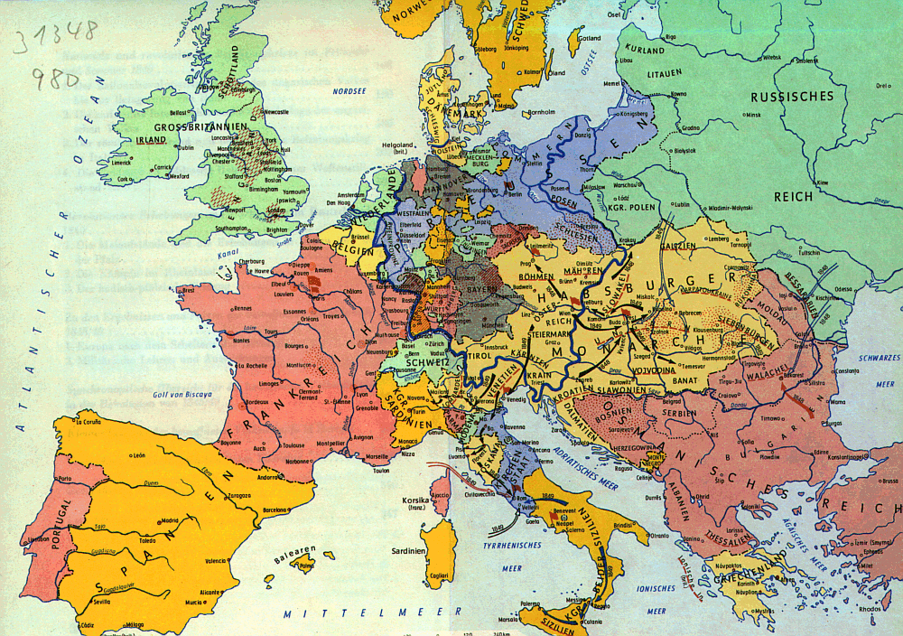
EARLY 20TH CENTURY EUROPE

Slide 6
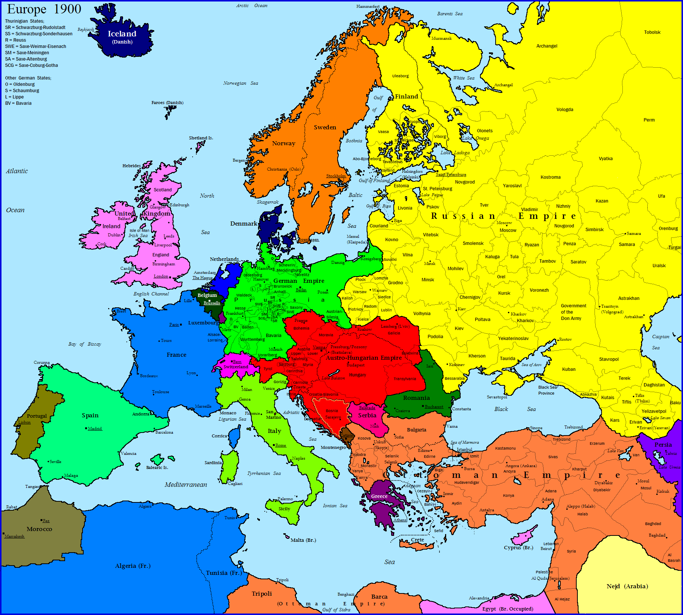
EARLY 20TH CENTURY EUROPE

Slide 7
POOR GERMANY
MOST of the time ___________ gets the blame for all of these
It was only in the early 1900s that they came together to form their country
They wanted to catch up to the other European Powers

Slide 8
IMPERIALISM
Definition: _____________________________________
________________________________________________
Most European Powers were competing for colonies and their resources
Anybody think of a good example of a colony back then???
When a war began between European countries, ALL countries of the world were dragged into it

Slide 9
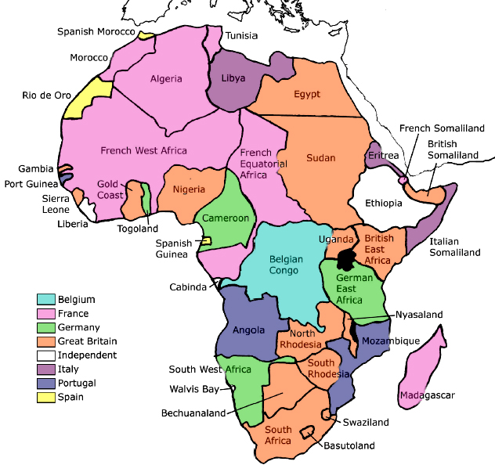
The British Empire took in India, South Africa, Australia, New Zealand, Canada, Hong Kong, parts of north Africa, islands in the Pacific and Caribbean and concessions in China.
Russia ruled modern-day Poland, Finland, Estonia, Latvia, Lithuania, the Ukraine, Georgia and several regions in central Asia, such as Kazakhstan.
France was the imperial power in modern-day Vietnam, Laos and Cambodia, areas of West Africa and India, small colonies in South America, islands in the Pacific and Caribbean.
Germany had seized control of modern-day Tanzania, Namibia and the Cameroon in Africa, German New Guinea and concessions in China.
- See more at:

Slide 10
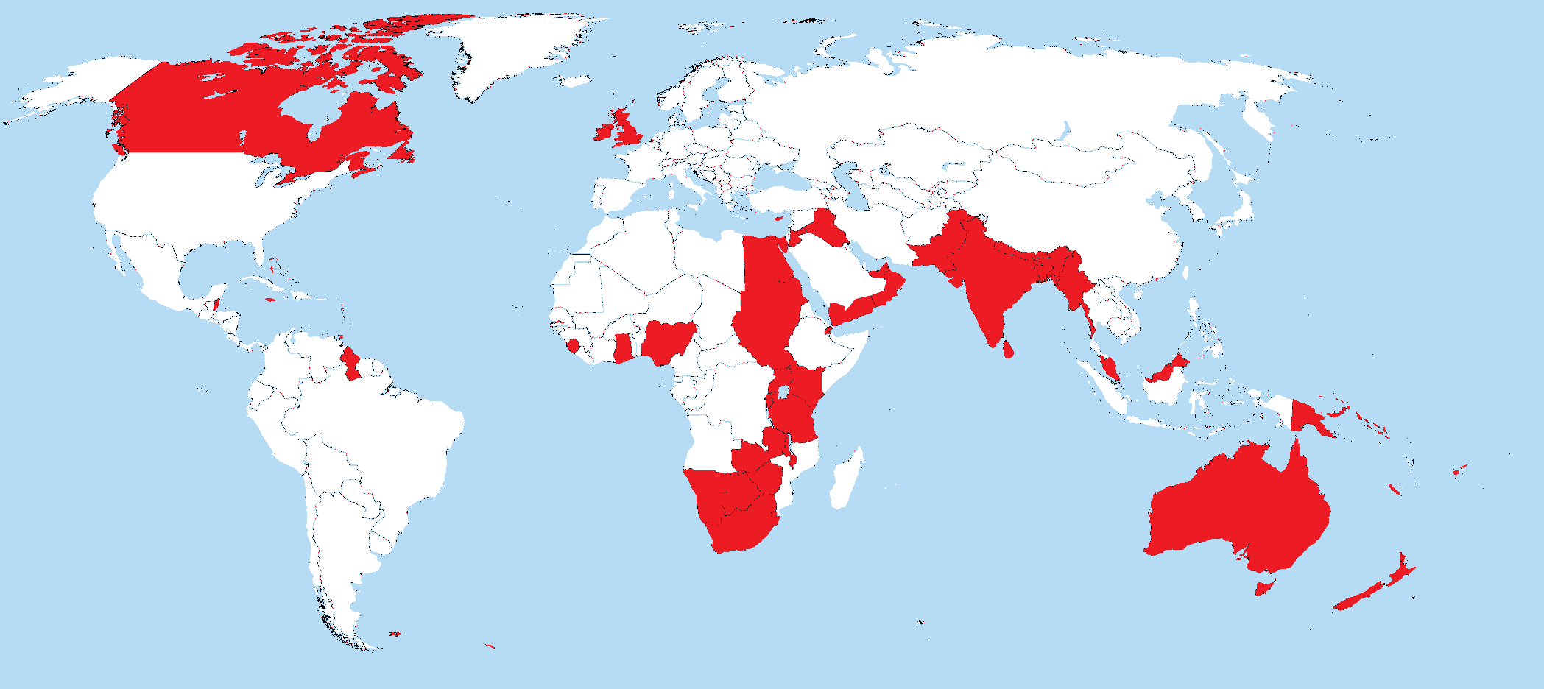
BRITISH IMPERIALISM

Slide 11
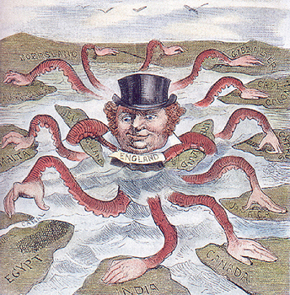

Slide 12
MILITARISM
Definition – ______________________________________
_________________________
In the early 1900s, an arms race developed between ______ and __________
Each country tried to build a bigger ____ and _____ than the others
Britain had the largest navy in the world…WHY??
Dreadnought Race!!

Slide 13
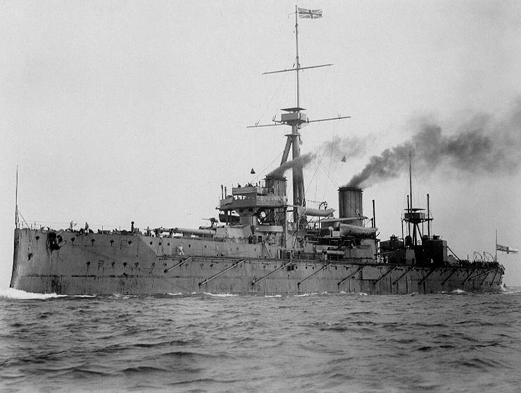

Slide 14
MILITARISM
If you were one of the OTHER countries in Europe, what would you be worried about? What might you DO?

Slide 15
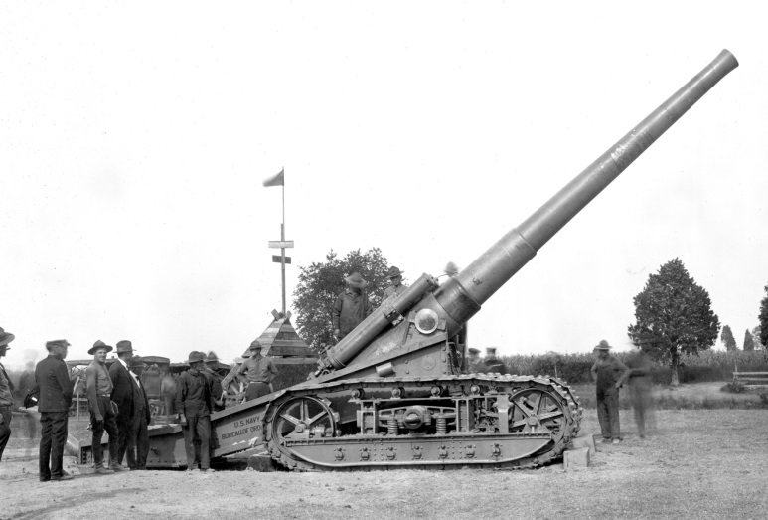
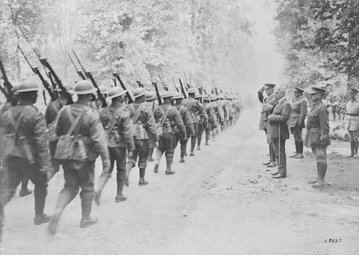
The Total Defence Expenditure of the Powers (in million £ )(Germany, Austria-Hungary, Italy, Britain, France and Russia)
1870 | 1880 | 1890 | 1900 | 1910 | 1914
94 | 130 | 154 | 268 | 289 | 398

Slide 16
ALLIANCE SYSTEM
Definition: _______________________________________
Triple Alliance – ___________________________________
Triple Entente – ___________________________________
Both alliances were prepared to go to war if any partner was attacked – domino effect (this is how most BIG brawls happen)
Who looks better off??

Slide 17
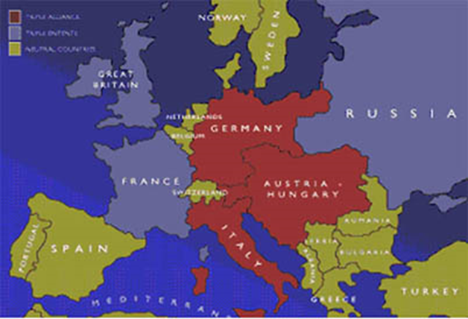

Slide 18
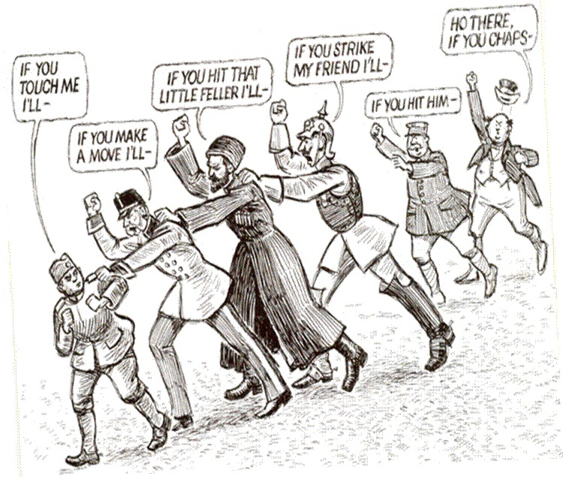

Slide 19
NATIONALISM
Definition: _______________________________________
Assuming your language and culture is better than others
The 1914 borders of Europe were relatively new, and citizens of each country were willing to go to war to prove their country was better than others
When do Canadians typically show a lot of nationalism?

Slide 20
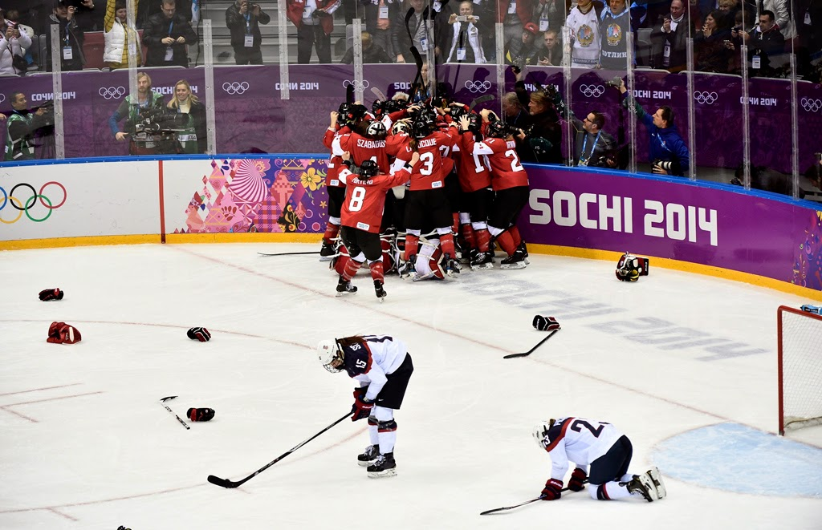

Slide 21
SHORT TERM CAUSES OF WWI
ONE shot, by ONE person (a teen), started the biggest war the world had ever seen
The event is known as: ____________________________
______________________________
Austrian heir, Archduke Ferdinand and his wife are killed by a Serbian terrorist group, the _____________, in Sarajevo, Bosnia – a state within the Austro-Hungarian Empire

Slide 22
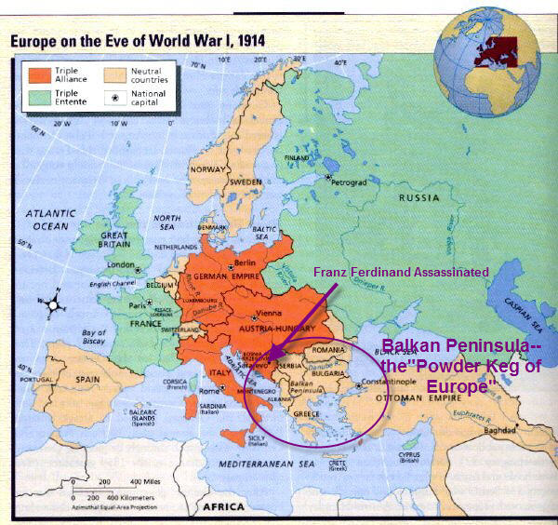
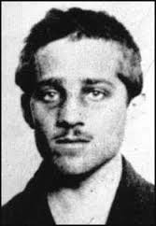
ASSASSINATION CON’T
Black Hand – Serbian Nationalist Terrorist group.
Resent being a part of the Austro-Hungarian Empire
Serbia historically closer to Russia not Austria-Hungary
______________________Kills the A-H heir

Slide 23
The SPARK - the assassination of Archduke Ferdinand Continued……
Summer 1914
Alliances kick in
July 29
Russia mobilizes
July 28
Austria invades Serbia
July 25
Serbia replies, rejecting them
July 23
Austria sends ultimatum (list of demands) to Serbia
June 28
Archduke Ferdinand is assassinated at Sarajevo

Slide 24
The SPARK - the assassination of Archduke Ferdinand Continued……
Canada and the
British Empire are
at war
Summer 1914 - continued
Germany invades Belgium as a way to get to France
Britain declares war on Germany – protecting Belgium
August 4 - 5
August 3
France mobilizes forces to assist
Russia
- Germany declares war on France
July 29
- Russia mobilizes army along borders with Austria and
Germany
- Germany declares war on Russia

Slide 25
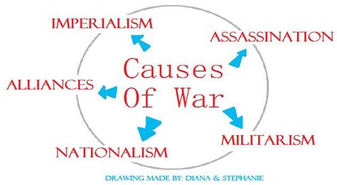
SIGNIFICANCE ACTIVITY – Let’s rank them!!
FOLLOW RANKING INSTRUCTIONS

Slide 26
SIGNIFICANCE RANKER

Slide 27
World War 1 Begins
The Schlieffen Plan
Designed to prevent a war on two fronts
Take France in 6 weeks, by surprise by going through Belgium
Once France falls, move troops east to fight Russia

