Slide 1
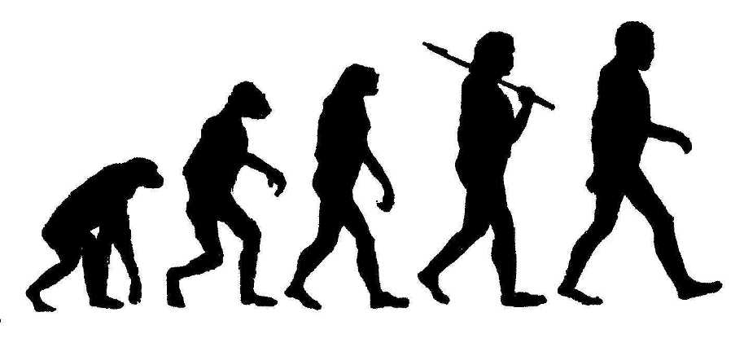
The March To Civilization

Slide 2
Australopithecus – The 1st
Earliest hominid biped
Hominid - Primate walking upright
Biped - 2 feet
4 million years ago
Lucy - Name of our oldest fossil remains of Australopithecus

Slide 3
Major Change
By 1.7 million years ago, Australopithecus went through enough significant changes to suggest they had been replaced by a new species: Homo Erectus
Most notable changes were to brain and body size
By 1.2 million years ago, Homo Erectus only hominid around

Slide 4
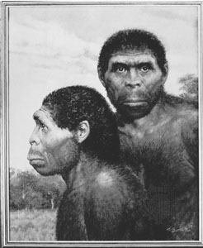
Lucy
Homo Erectus

Slide 5
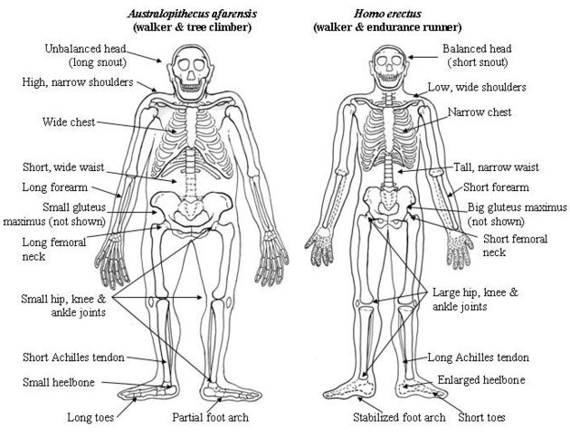

Slide 6
Homo Sapiens – “Wise Man”
400,000 years ago, enough significant changes to reclassify again
By 100,000 years ago 3 types of Homo Sapiens
Europe & Near East – Homo Sapiens Neanderthalensis (Neanderthals)
Africa – Homo Sapiens Sapiens (Modern man’s ancestor/Cro Magnon)
Asia – Group has too few fossils to define
50,000 years ago, Homo Sapiens invaded Europe and led to the extinction of Neanderthals

Slide 7
Neanderthal Society???
Small groups thinly spread over the landscape with little interaction
Males lived separate from females and children as hunters and gatherers
Females gathered food closer to cave
No permanent relationships or family units
No formal leaders, laws or rules to follow
Can this be deemed a society???

Slide 8
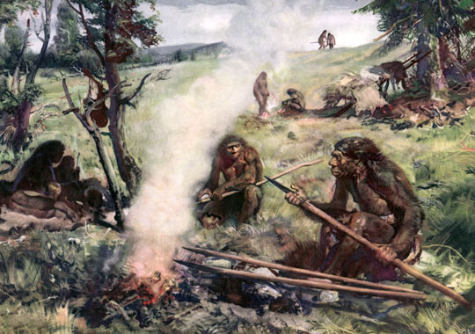
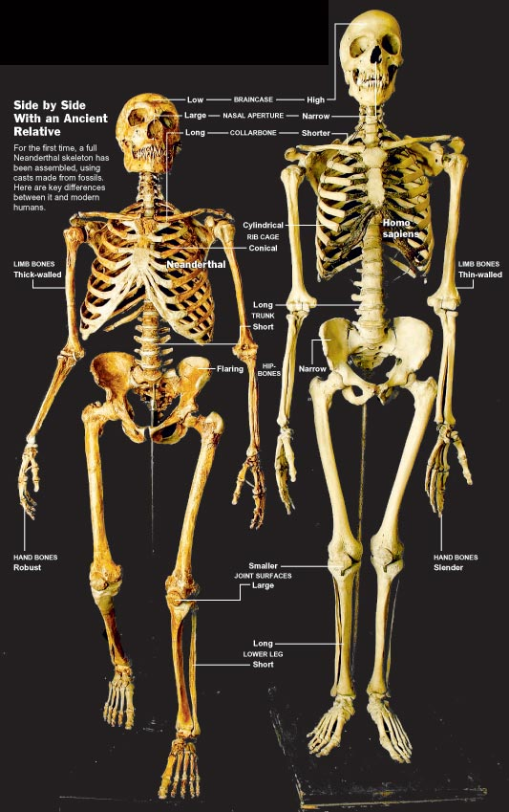
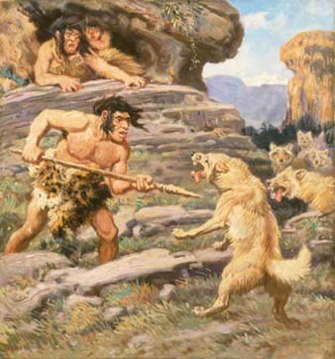

Slide 9
The Great Leap Forward
35,000 years ago 2 monumental changes happened
The development of modern anatomy
Homo Sapiens Sapiens had reached an anatomically distinct stage alike to our own
The beginning of innovative behaviour
Creative tools with specific purpose
Trade and aesthetic appreciation
Lascaux cave paintings
17300 years ago

Slide 10
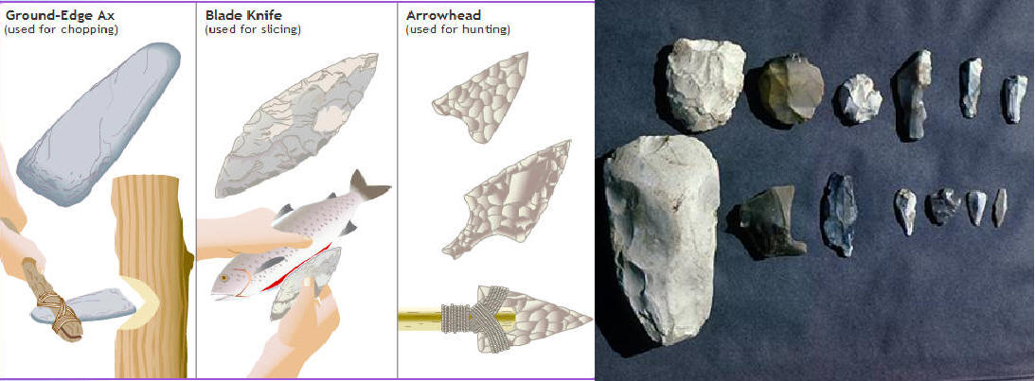
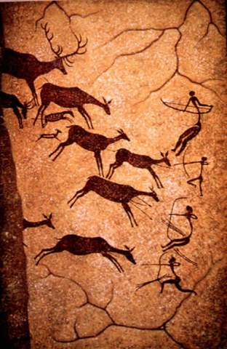
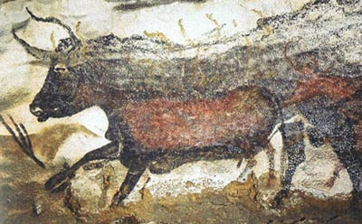
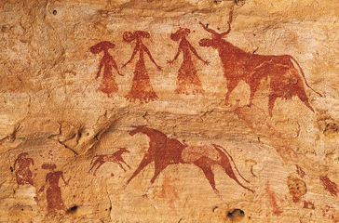

Slide 11
The Stone Ages
Paleolithic Age (50,000 – 10,000 years ago)
Paleo = Old Lithos = Stone
Neolithic Age (9000 – 4000) Neolithic Revolution
Neo = New

Slide 12
Comparing the Stone Ages
PALEOLITHIC
Small groups of 5-10 families with nomadic/semi-nomadic life
Shift towards stronger social relationships
Social Stratification – emergence of leadership and social classes
Patriarchal Society – Men major authority role & hunter
- Women made clothing and gathered

Slide 13
Comparing the Stone Ages
NEOLITHIC
Neolithic Revolution: People abondoned semi-nomadic lifestyle and began farming in permanent settlements
2 major factors: Growing plants & Domesticating animals
Increase in food supply led to more specialized occupations
Interaction between settlements, mainly in regards to trade. Sometimes marriage & even 1st religious activities

Slide 14
MANKIND CLIPS

Slide 15
Other Theories
Creationism
Deism
Clockmaker Hypothesis
Erich von Daniken
If you like Prometheus, Alien vs Predator, or Indian Jones and Crystal Skull, you’ll like him

Slide 16
Erich von Daniken
Intelligent Strangers
Writing in Mesopotamia talk of them
Artifacts beyond technological knowledge at the time
Similar art from unrelated cultures show space vehicles
Religion is our interpretation of them (very Stargate)

