Slide 1
HISTORY OF THE ISRAEL – PALESTINE CONFLICT

Slide 2
ANCIENT BACKGROUND
BOTH Jews & Muslim Arabs believe they are descended from Abraham (c. 4000 BCE)
BOTH have several ancient holy sites in Jerusalem
Timeline-wise, Israelis settle first, yet are dispelled by the Roman Empire which banned Jews from the city and renamed it Syria Palaestina, or Palestine
When Muslim Arabs captured Jerusalem in the 7th Century CD, they lived in peace w/ Jews and Christians alike.

Slide 3
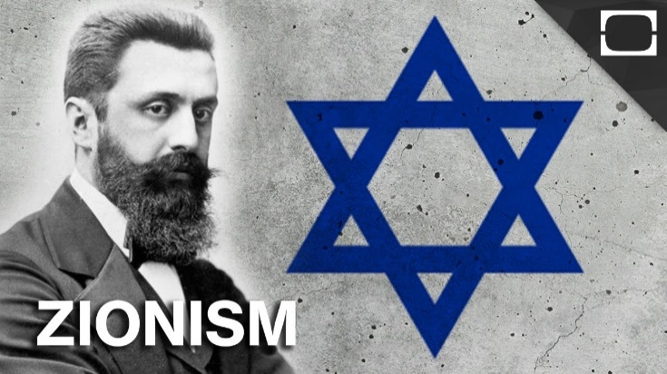
ZIONISM
Although ancient Israel had disappeared into history, there were always Jews who kept its memory alive.
19th Century saw the Zionist movement, which sought to re-create a Jewish state in Palestine
“A land without a people for a people without a land.”

Slide 4
THE TWICE PROMISED LAND
When WWI began, the Ottoman Empire controlled Palestine
Britain to Arabs – Promised Arab ruler that they would help create an independent Arab state in the area in return for assistance in overthrowing the Turks
Britain to Jews – Promised Zionist leader a new Jewish homeland in Palestine, so long as this did not infringe on the rights of non-Jews
BALFOUR DECLARATION

Slide 5
“His Majesty’s Government views with favor the establishment in Palestine of a national home for the Jewish people, and will use their best endeavors to facilitate the achievement of this object, it being clearly understood that nothing shall be done which may prejudice the existing civil and religious rights of existing non-Jewish communities in Palestine.” The Balfour Declaration 1917

Slide 6
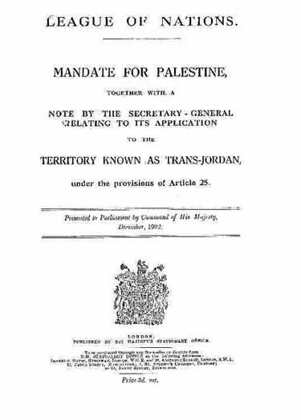
1920s & 1930s
Massive influx of Jews
They’d purchase land from wealthy, absentee Arabs,
then evicted the tenant farmers
Led to violence and counter-violence
Arabs offered a legislative council, but had to validate
Balfour Declaration…which it rejected.
Eventually hands problem over to United Nations

Slide 7
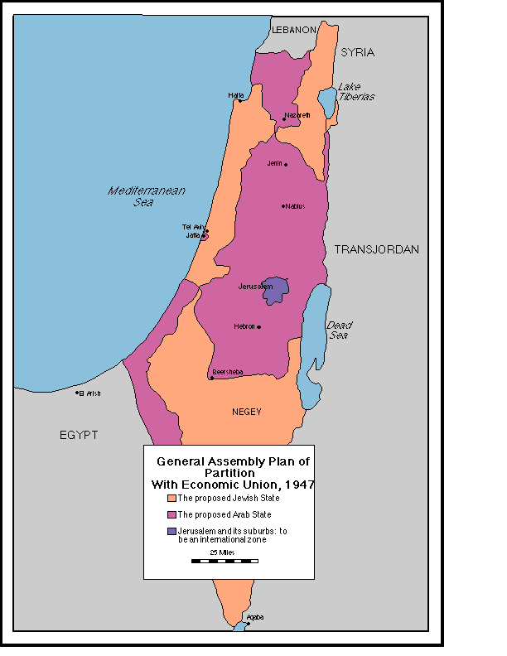
UNITED NATIONS 1947 PARTITION PLAN
Plan gives Jews their own state, based on where they
purchased the most land
Arabs would control the remaining territory
Jerusalem given international status
Jews support, Palestinians opposed…and FOUGHT!!

Slide 8
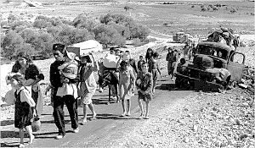
1948 CATASTROPHE
Zionists seized all the land under the UN plan…and more…doing so forced Arabs to flee from their homes
1 million Palestinian refugees were created in this time
On May 15, 1948 British troops leave and it’s now just the 2 w/ UN oversight
Zionists proclaim new Jewish statehood…Palestinians
proclaim “Catastrophe”

Slide 9
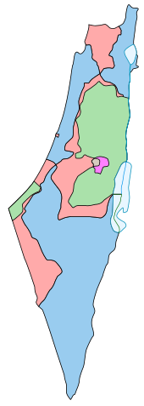
1948 CONFLICT
Palestinians go to war over the displacement….QUICKLY defeated
Israelis seize 1/3 extra territory from original plan
Egypt & Jordan annex what was left…Palestinian refugees all over
Israel’s 1st President said, “A miraculous clearing of the land; the
miraculous simplification of Israel’s task.”
Arab states refuse to recognize Israel, vowing to fight another day

Slide 10
1967 – THE 6 DAY WAR
Egypt and Syria mobilize on Israel’s borders…Israel attacks first…who’s fault??
Jordan joins Arab nations…Israel wins quickly
HUGE land grab!!
West Bank, Golan Heights, Gaza Strip and ENTIRE Sinai Peninsula
East Jerusalem, containing some of Islam’s holiest sites, now under Jewish control
Another 300 000 Palestinians displaced

Slide 11
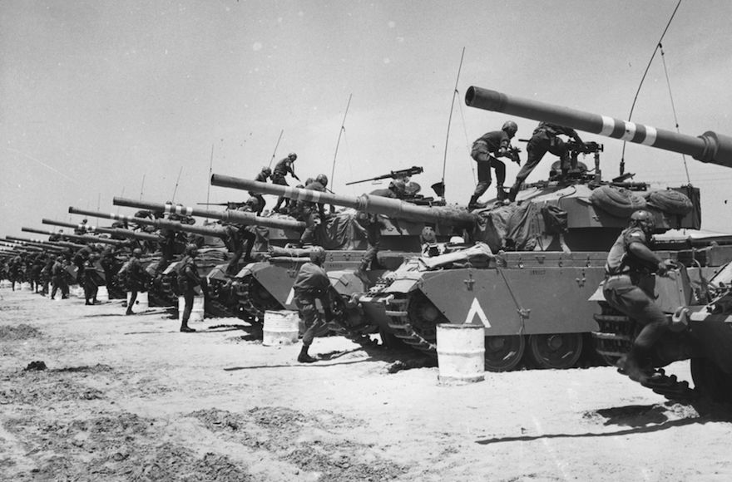
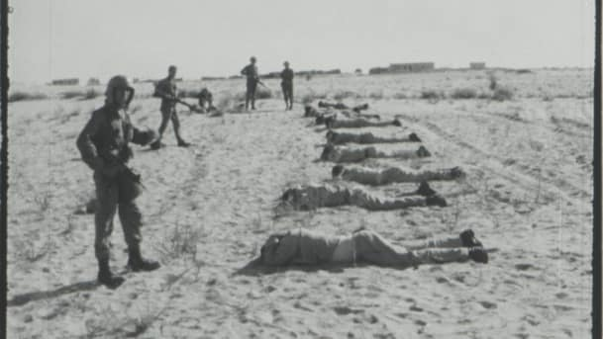
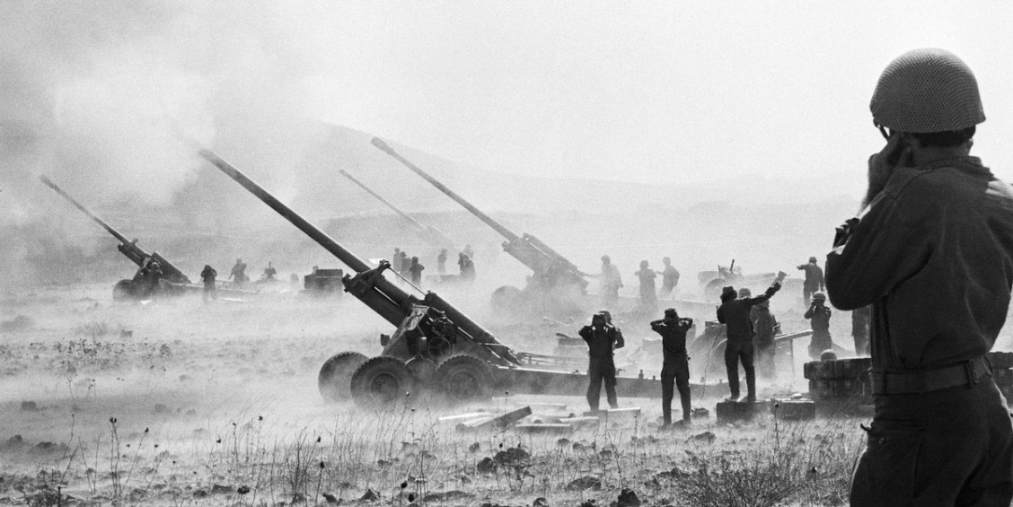
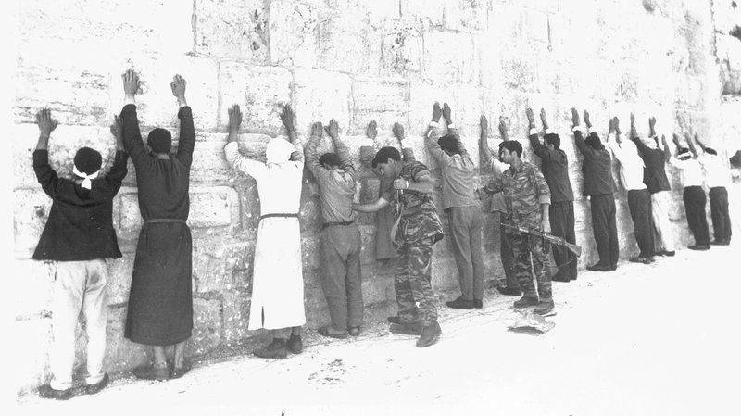

Slide 12
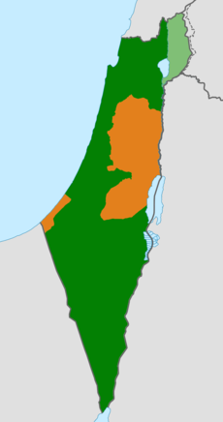
1967 RESOLUTION 242
Security Council passes Resolution 242
Israel is to withdraw from the territories it had occupied in
exchange for Arab recognition of its sovereignty and security
Palestine says NO
Critics of Israel point out that it still occupies a lot of this land
Israel argues that its enemies have no intention at peace
1980 – Israel declares all of Jerusalem its capital

Slide 13
THE PLO
After realizing that liberation couldn’t be achieved by the help from Arab neighboring states, they took matters into their own hands
The Palestine Liberation Organization (PLO) was formed in 1964 by a summit of Arab governments
Political action to validate existence of Palestine
Guerrilla warfare tactics taken against “illegal settlements”
350000 of them in the West Bank, 200000 in East Jerusalem

Slide 14
1987 INTIFADA
“Awakening” or “Shaking off”
A massive uprising that pitted thousands of ordinary Palestinians against the Jewish state
A Jewish salesman was stabbed to death by an Arab, and days later an Israeli army vehicle plowed into a group of Palestinians at the Jabalya refugee camp in Gaza (killing 4)…taken as deliberate
Days…months…years – civil disobedience, strikes, riots, throwing stones. Israel responded w/ live rounds at crowds

Slide 15
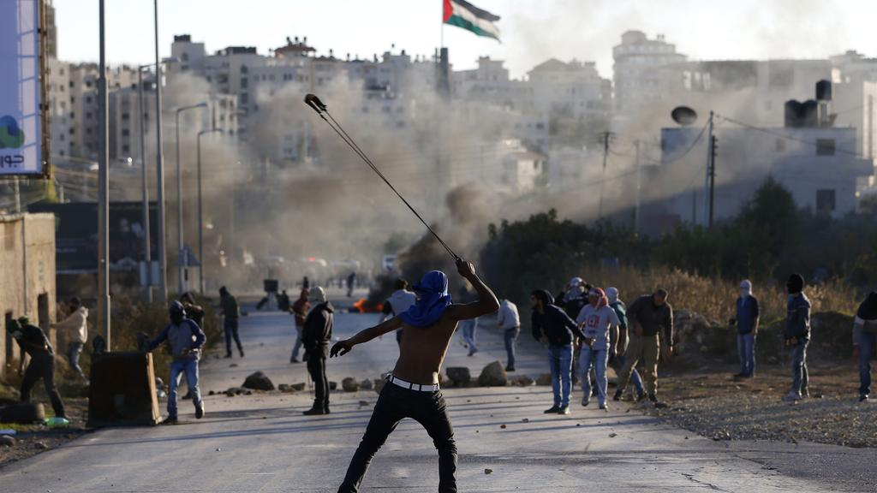
INTIFADA CON’T
Israel brought an “iron fist” policy of mass arrests and evictions
Palestinians felt united…eventually joined by Hamas – a VERY extremist group

Slide 16
