Slide 1
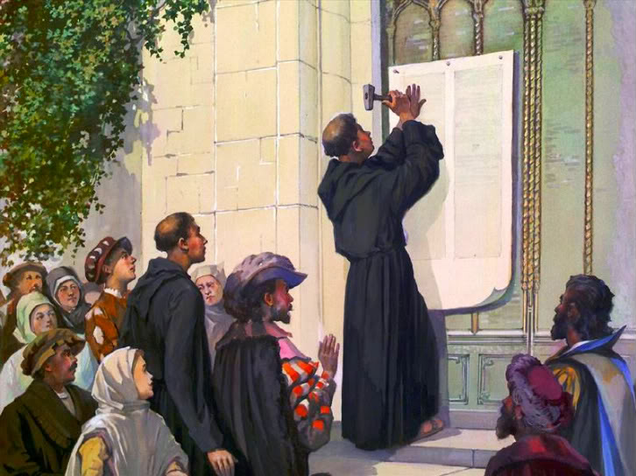
THE REFORMATION

Slide 2
Middle Ages Church
Anyone remember what 3 tasks the Church had set out for society?
Corpus Christi good example of one of them…
How does this showcase the dominant role of the Church?

Slide 3
Catholic Church Dominant Role
Life cycle – sin, confession, contrition, penance
Constant fear of dying…why??
Indulgences – “As soon as coin in coffer rings, a soul from purgatory springs.”
St. Peter’s Basilica – Pope Leo X

Slide 4
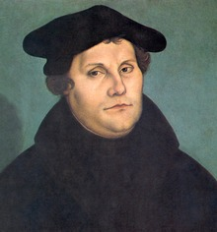
Enter Martin Luther
1483-1546
Obsessed w/ salvation and how to attain it
Found sacraments problematic
Stressed reading the Bible, inner peace, personal relationship w/ God
What was the source of his inspiration/teachings?

Slide 5
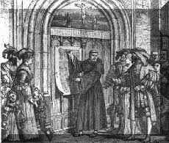
Martin Luther
HUGH problem w/ Pope’s project & indulgences in general
Is a financial transaction true contrition?
Wrote ‘Ninety-Five Theses”
BLASTS indulgences and current infrastructure of Catholic Church

Slide 6
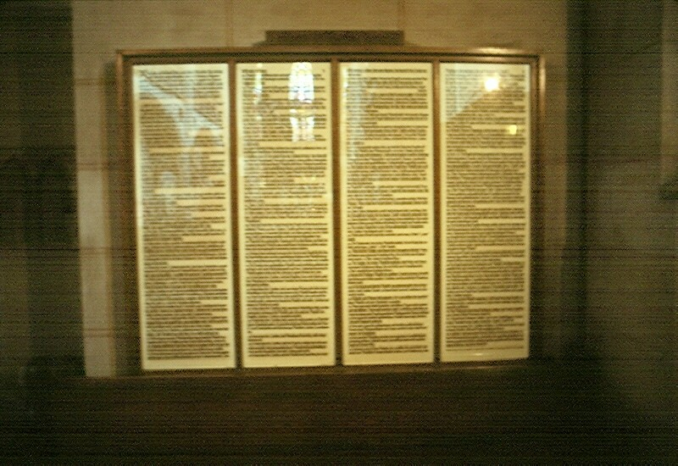
95 Theses
Posted on the door of the Wittenberg Castle (1517)

Slide 7
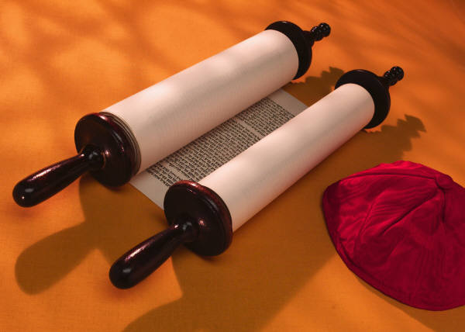
95 Theses
It is mere human talk to preach that the soul flies out immediately the money clinks in the collection-box (27)
Christians should be taught that he who sees a needy person and passes him by, although he gives money for pardons, wins himself not Papal indulgences by the Wrath of God (45)
…if the Pope knew the exactions of the Indulgence-preachers, he would rather have St. Peter’s reduced to ashes… (50)

Slide 8
Luther’s Other Works (All Same Concept)
Address to the Christian Nobility of the Germany Nations – Urged princes to reject papal authority
On the Babylonian Captivity of the Church – authority in the church had to be based on teachings found in the Bible (sola scriptura)
On Christian Freedom – A Christian has all he needs in faith and needs no works to justify him (sola fide)

Slide 9
SOLA FIDE
“Good works do not make a good man, but a good man does good works.”
Idea that FAITH will LEAD to that which is desired by God

Slide 10
KINGDOMS BAND
“How you live means more than what you believe.”
Do they appear CATHOLIC or PROTESTANT?
Do we BELIEVE something first and THEN pick a religion, or do we pick a religion and follow its ideals??

Slide 11
Luther’s & The Sacraments
Catholic Church (7) – Baptism, Confirmation, the Eucharist, Penance, Matrimony, Holy Orders, and Extreme Unction
Luther (2) – Baptism, Eucharist
Why Only 2???

Slide 12
Church Response
1520 – Pope Leo X condemns Luther’s teachings and orders him to recant
1521 – Charles V & the Diet of Worms (not what it sounds like)
Demanded to recant – relies on Scripture & reason
Excommunicated (Why not a big deal) & Outlaw
Fled to Saxony
Translated New Testament into German vernacular

Slide 13
Reformation Spreads
Zurich – Ulrich Zwingli – Swiss Reformation
Geneva – John Calvin – Calvinism
Zurich/Munster – Michael Servetus/Menno Simons – Anabaptists (Mennonite/Amish)
England – Henry VIII & Thomas Cranmer & Cromwell – Anglican

Slide 14
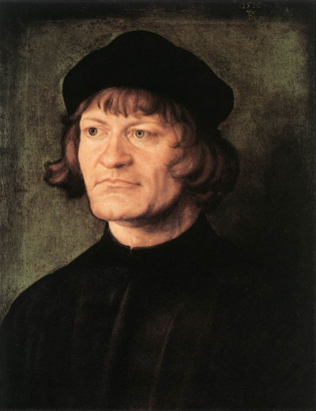
Swiss Reformation
Zwingli (1484-1531)
Country priest w/ humanist influences
Led Zurich to become a Protestant city
Saw reform as communal movement (non-Luther)
Suppressed religious images & monastic institutions
New Eucharist concept that Luther
Held old concept of celibacy

Slide 15
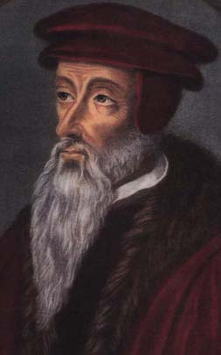
Calvinism
Calvin (1509-1564)
Institutes of the Christian Religion (1536)
Doctrine of absolute power of God
Predestination
“The word of God takes root and grows only in those whom the Lord, by his eternal election, has predestined to be his children”
Obliged to live good life…good life will be sign you are in
Pastors, Teachers, Elders, Deacons
No clergy powers

Slide 16
Calvinism
SUPER rigid – no religious toleration
Servetus (Anabaptist) burned at stake
Even had Church Courts
Similarities to Zwingli
Later followers in France - Huguenots

Slide 17
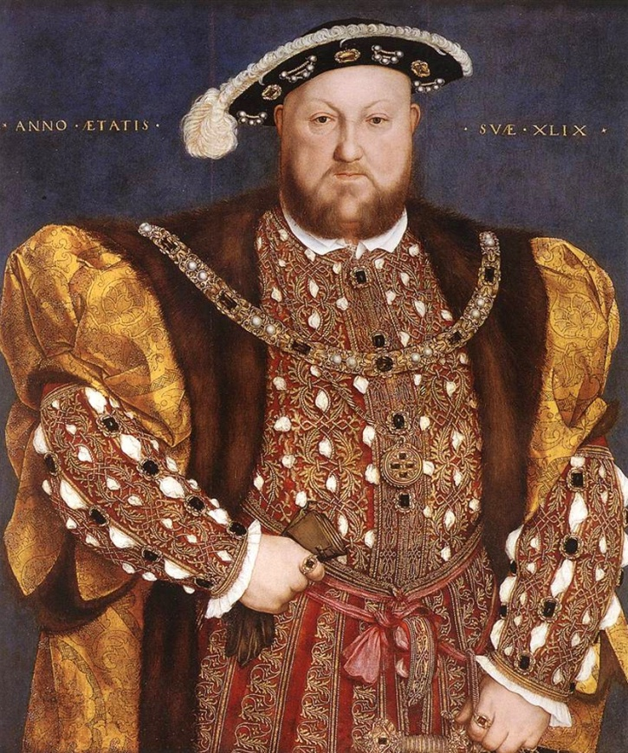
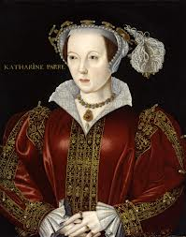
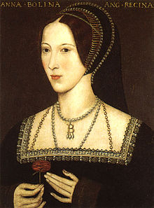
Anglican

Slide 18
Henry VIII
1509-1547
Strong supporter of Catholic Church early on
Changed view due to desire for divorce….weak!!
Charles V – Catherine – Pope Clement VII
Thomas More (humanist) opposed break from Catholic Church (got him killed)
Thomas Cranmer & Thomas Cromwell (Protestants)
Act of Supremacy 1534 – King now head of Church of England (sneaky how they made it work)

Slide 19
NOW WHAT???
So now we have SEVERAL different religious sects spread across Europe….all of which are not recognized by Charles V (Holy Roman Emperor) the Catholic Church &
Catholic Church even organizes a “Counter-Reformation”…(You’ll do a reading on this)
What next????

Slide 20
Religious Settlement
Peace of Augsburg – 1555
Charles V formally acknowledged that sovereign Princes could choose the religion to be practiced in their territory (cuius regio, eius religio)
Only recognized Lutherans & Catholics as legitimate (Zwingli & Calvin not legit)
Seems like a happy ending but TOTAL disaster for many areas on the horizon
St. Bartholomew’s Day Massacre in Paris
Elizabeth I’s ascension

Slide 21
