Slide 1
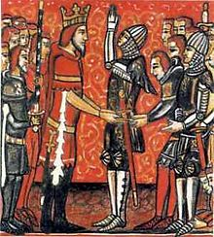
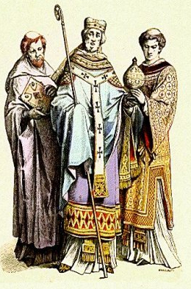
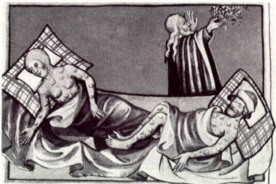
THE MIDDLE AGES

Slide 2
Basics
5th – 15th Century
Is it Dark, Medieval, or Middle??

Slide 3
Feudalism
Post-Roman world full of violence
Weak turn to strong for protection, strong want
something in return
Enter Feudalism – worked due to the mutual obligation/benefits inherent in the system

Slide 4
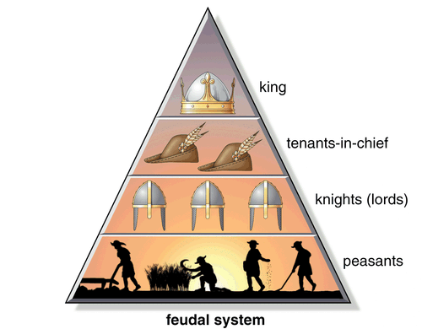
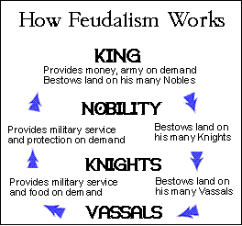
Feudalism

Slide 5
Feudalism (mocked)
https://www.youtube.com/watch?v=ZtYU87QNjPw

Slide 6
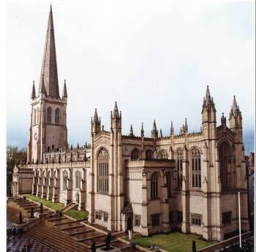
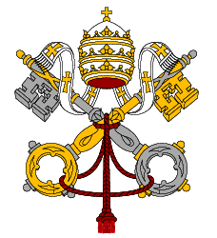
The Roman Catholic Church
By FAR, the dominant institution of the Middle Ages in Europe

Slide 7
The Roman Catholic Church
Pervaded every aspect of life
Defined social ethic & created social control
3 Principle Tasks – Providence, Salvation & Community

Slide 8
3 Tasks
Providence – God’s Justice on Earth – No accidents (No Country For Old Men Coin Flip…but w/ God)
Can be influenced through prayer/deeds
Salvation – Life after death – Purgatory
Community – Strength in Groups – Festivals, Put Others First, Self-Denial, Chastity, Charity

Slide 9
Scratch my back & I’ll Scratch Yours
Church was granted favors by Kings (land, tax exemption, immunity in courts, positions in courts) and in return the Church would endorse kings to help secure their rule
Kings looked to Church to supply educated administrators to help run kingdoms and in return kings would enforce laws that prohibited other religions…(Ironic church wants this…why??)

Slide 10
The Honor Code
Only social/ethical opposition (at times) to Christianity (What was ‘cool’ at the time)
Revenge vs. Forgiveness / Look out for Friends vs. Universal Brotherhood
Both praised justice, courage, generosity, and honesty…BUT….obvious differences
How do men get honor? How do women?

Slide 11
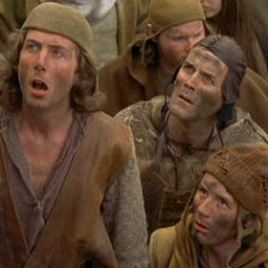
Health in Middle Ages
No Antibiotics / Antiseptics
No comprehension of germs
Poor diet w/ brutal hygiene standards
No sewers
Famine
Diseases: Cholera, Smallpox, Typhoid, Influenza

Slide 12
Bubonic Plague/Black Death
1/3 of Europe died
http://www.youtube.com/watch?v=grbSQ6O6kbs
Social impact ranged from panic to wild debauchery as the end was near
Church suffered HUGE!!...WHY???

Slide 13
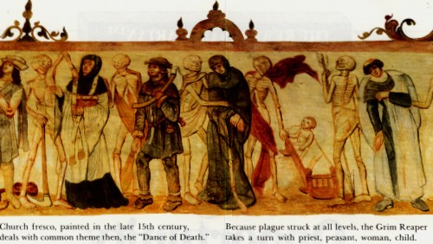

Slide 14
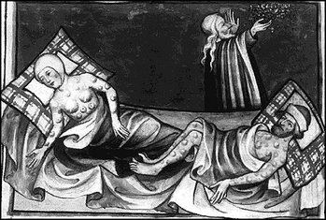

Slide 15
Final Thoughts
Does this look like a civilization on the brink of a breakthrough in culture, religion, and institutional policy??
http://www.youtube.com/watch?v=TczFkRnBto8

